Slide 1

DscWorkshop Overview
Raimund Andree

Slide 2
Team
Jan-Hendrik Peters
PFE at Microsoft
Twitter: @NyanHP
Raimund Andrée
PFE at Microsoft
Twitter: @raimundandree
Gael Colas
Contractor in Config PG
Twitter: @gaelcolas

Slide 3
What is this about?
End-to-end DSC project template
Follows principles of The Release Pipeline Model

Slide 4
Agenda
Why DevOps in an Ops World?
DSC Basics
Why the DscWorkshop Blueprint?

Slide 5
Why DevOps in an Ops World?
Infrastructure Problems
The solution: Release Pipeline (learning from the devs)

Slide 6
Infrastructure Problems
Evolving complexity lowers change delivery capacity
Missing trust in change process
No automated tests
No documentation (that someone finds and reads)
No visibility of the defined state (intent)

Slide 7
Build trust & abstract complexity
CHANGE
CHANGE
CHANGE
Applying Transforms (the action to get from A to B)
CHANGE
Promoting Artefacts
Delivery
Delivery
Notes:
Changes are imperative
Shifting the mindset to delivery allows to think in state, and eventual convergence.
This is the same principle of abstraction the DSC Resources provides between tools and the DSC DSL defining, well, states.

Slide 8
Artefact (or Artifact)
Arte + Factum = Something made by / of Art
Art = work produced by human creative skill and imagination.
An unit or entity (something)
Created from human changes (initially)
Versioned (uniqueness)
Tested (to build trust)
Immutable (or you’ll lose trust)
ABSTRACTION

Slide 9
The solution: Release Pipeline
“The pipeline […] applies its rules in a rigorous, unemotional way” - Mark Schwartz, The Art of Business Value
Artefact
Source
Artefact Repository

Slide 10
CI/CD Release Pipeline for DSC

Slide 11
Important Principles and Technolgies
Source Control (Git)
Linting (PSScriptAnalyzer)
Unit- and Integration Testing (Pester)
Dependency Resolution (PSDepend)
Build Pipeline (InvokeBuild)
Automatic Versioning (GitVersion)
CI/CD Release Pipeline (Azure DevOps)

Slide 12
Why DevOps?
Infrastructure Problems
The solution: Release Pipeline (mostly Dev)

Slide 13
DSC Basics
What is Desired State Configuration?
Components of Desired State Configuration
Composite resources
From static to dynamic with configuration data

Slide 14
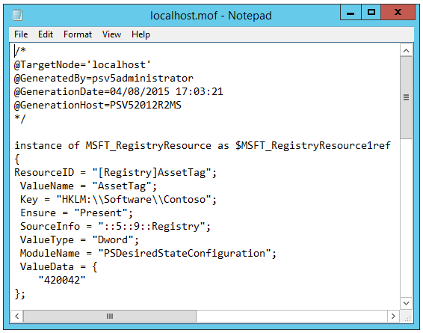

At the end, it’s MOF
MOF - Managed Object Format
Industry standard text files containing resource and configuration data
Consumed by WMI/CIM
localhost.mof

Slide 15


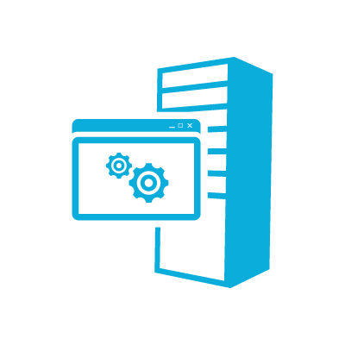

Push / Pull
Authoring
Staging
Nodes
Config Pulled
Configs Deployed
Server1
Config Pulled
IIS
Server1.mof
Configs Deployed
Server1.mof
Server1
Server1.mof
File Share
Server1.mof
Server1
Notes:
Authoring
DSC consumes MOF files.
MOF files can be created using any text editor. PowerShell v4 makes it easier to create a MOF file because it has declarative syntax extensions and Intellisense.
Staging
Pull → DSC Data and custom resources are stored on a central IIS web server with a well defined OData interface that functions as the “Pull Server”. Target Nodes connect using a URI and a unique identifier to retrieve its configuration.
Push → DSC Data is pushed to the target nodes. Custom resources must exist on the target nodes.
Nodes
DSC data is pulled or pushed to the “Local Configuration Store” which contains the current, previous and the DSC. The configuration then gets parsed and the relevant WMI provider implements the change.

Slide 16
Demo: Components of DSC
Configuration
Container for configuration items
Node
Optional component in a configuration
Contains node-specific items
Resource
The configuration item
configuration conf
{
node localhost
{
File foo
{
DestinationPath = 'C:\foo'
Contents = 'bar'
Type = 'File'
Ensure = 'Present'
}
}
}

Slide 17
Demo: Config Data and Scalability
How do you maintain / change this script?

Slide 18
Why the DscWorkshop Blueprint?
The pain with DSC
The gain with the DscWorkshop

Slide 19
The pain with DSC (in most ops teams)
DSC mostly seen as a replacement for classic scripting
No best practices how to design a DSC project, hence
No or improper separation of config data and code (resources)
No separation of configurations into composite resources
No flexible config management
No scalability
No single build script
No CI/CD
Absolutely no trust as changing config data gets a nightmare

Slide 20
The gain with the DscWorkshop
Flexible and scaling config management using Datum
New way of using Composite Resources as assignable configurations
Dependency resolution with PSDepends
Build script that works on various build systems
Creates all DSC artifacts (MOF, MetaMOF, RSoP, CompressesModules)
Addresses a lot of weird DSC shortcomings
Error handling and multi-threading
Testing configuration data and build results using Pester
Works for push, pull, on-prem and Azure

Slide 21
Some extra things added
Features
Maintenance windows
Tagging MOF files
Extended Reporting (for DSC Pull on-prem using SQL)
DSC diagnostic endpoint on each node using JEA
Learning material
Self-paced learning exercises going through the whole CI/CD on Azure DevOps

Slide 22
How to use it and contribute to it
Everything is on Git
DSC
https://github.com/gaelcolas/Datum
https://github.com/dsccommunity/DscWorkshop
https://github.com/dsccommunity/CommonTasks
Deploying the lab
https://github.com/AutomatedLab/AutomatedLab

